Slide 1


Hospital Bed Occupancy & Capacity Utilization Analysis
This project analyzes hospital bed utilization across key services: Emergency, Surgery, General Medicine, and ICU, using weekly operational data. The dashboard evaluates occupancy trends, patient flow dynamics, length of stay, and service-level capacity differences to identify patterns of congestion, underutilization, and operational pressure. The analysis aims to support data-driven decision-making in hospital capacity planning and service performance management.
MUSEDIKU JOSHUA
DATA ANALYST

Slide 2
METHODOLOGY
Our Approach to Capacity Analysis
This analysis was conducted using weekly hospital service data, processed and modeled in Power BI. Approach included:
1
2
3
Data Preparation
Metric Development
Trend & Comparative Analysis
Cleaning and structuring service-level data for Emergency, Surgery, General Medicine, and ICU.
Calculating key performance indicators: bed occupancy rate, average length of stay, refusal rate, and ICU vs. non-ICU utilization.
Examining weekly utilization patterns and comparing capacity across services.
4
5
Relationship Analysis
Insight Generation
Assessing how bed occupancy relates to patient satisfaction and operational performance.
Interpreting visual outputs to identify congestion risks and inform operational recommendations.

Slide 3
KEY INSIGHTS
Hospital Overwhelmed: Critical System Imbalance
Out of 13,000 patient requests, only 6,000 were admitted, leaving 8,000 refused care. More than half of patients never reach treatment.
Length of Stay (LOS): 7 days
Occupancy: 92.5%
Beds are tied up for a full week, slowing turnover. Even a 1-day reduction would free significant capacity.
Hospital runs above safe threshold (85%), leaving no buffer. Any surge (e.g., flu outbreak) immediately triggers refusals.
Demand–Capacity Ratio: 2.3
Patient Satisfaction: 79.6%
For every bed, more than two patients request care. Confirms systemic imbalance and chronic strain across services.
Appears moderate, but misleading. Surveys capture admitted patients only, masking dissatisfaction among 8,000 refused.

Slide 4
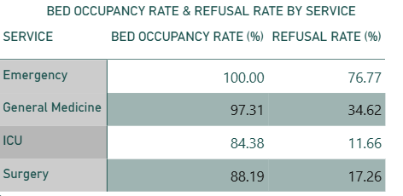
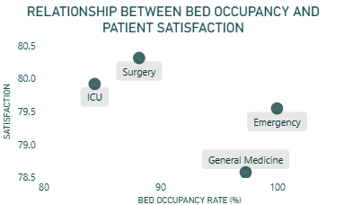
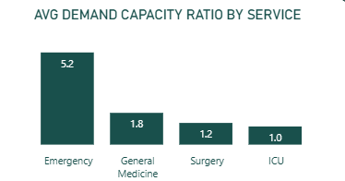
INSIGHTS
Service-Level Capacity Strain
Bed Occupancy Rate
Emergency (100%) and General Medicine (97.3%) operate at ceiling every week, driving high refusal rates.
Emergency: 3 of 4 patients denied (76.8%)
General Medicine: 1 in 3 refused (34.6%)
ICU (84.4%) and Surgery (88.2%) maintain healthier ranges of bed occupancy rate
Demand–Capacity Pressure
Emergency (5.2) and General Medicine (1.8) are severely under-resourced, with Emergency identified as the primary bottleneck.
ICU ratio: 1.0 (over-resourced relative to demand)
Scatter plot reinforces: Higher occupancy → lower satisfaction.

Slide 5
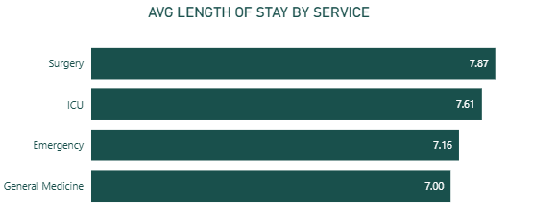
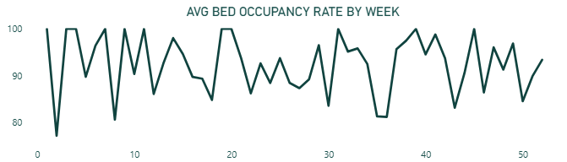
INSIGHTS
Patient Flow & Weekly Occupancy Trends
Patient Flow & Length of Stay (LOS)
Average LOS: 7–8 days. ICU and Surgery patients stay longest, impacting turnover.
Emergency cycles faster (~7 days) but demand overwhelms capacity.
LOS management is as critical as bed expansion.
Weekly Occupancy Trends
Occupancy rarely dips below 80%, with sustained peaks near 100%.
Evidence of systemic over-utilization, not isolated surges.
Seasonal events push demand beyond capacity, triggering refusals.
Impact: Hospital operates without buffer; minor shocks destabilize service.

Slide 6
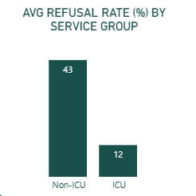
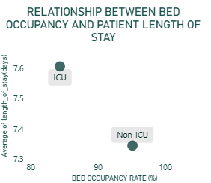
INSIGHTS
ICU vs. Non-ICU Comparison
ICU Metrics
ICU appears balanced:
Occupancy: 84.4%
Ratio: 1.0
Refusals: 12%
Long stays (8 days) limit flexibility.
Non-ICU Metrics
Non-ICU absorbs excess demand:
Occupancy: 95.2%
Ratio: 2.7
Refusals: 43%
Long stays : 7 days
Despite shorter LOS (7 days) of Non-ICU, sheer demand makes Non-ICU a critical pressure point.

Slide 7





RECOMMENDATIONS
Actionable Strategies for Capacity Optimization
Bed Occupancy & Refusals
Demand–Capacity Pressure
Patient Flow & LOS
Weekly Occupancy Trends
Optimize surgical discharge planning to reduce 7.87-day average length of stay, freeing capacity without new infrastructure.
Immediate capacity expansion in Emergency. Establish overflow protocols, additional beds, or rapid discharge pathways for stable patients.
Reallocate bed capacity from ICU (balanced demand) toward General Medicine and Emergency services.
Implement predictive demand modeling and flexible staffing. Establish a 90% occupancy ceiling as a safety threshold.
Quality Metrics
Measure satisfaction for refused patients and track "door-to-admission" times to enhance overall quality of care.

Slide 8
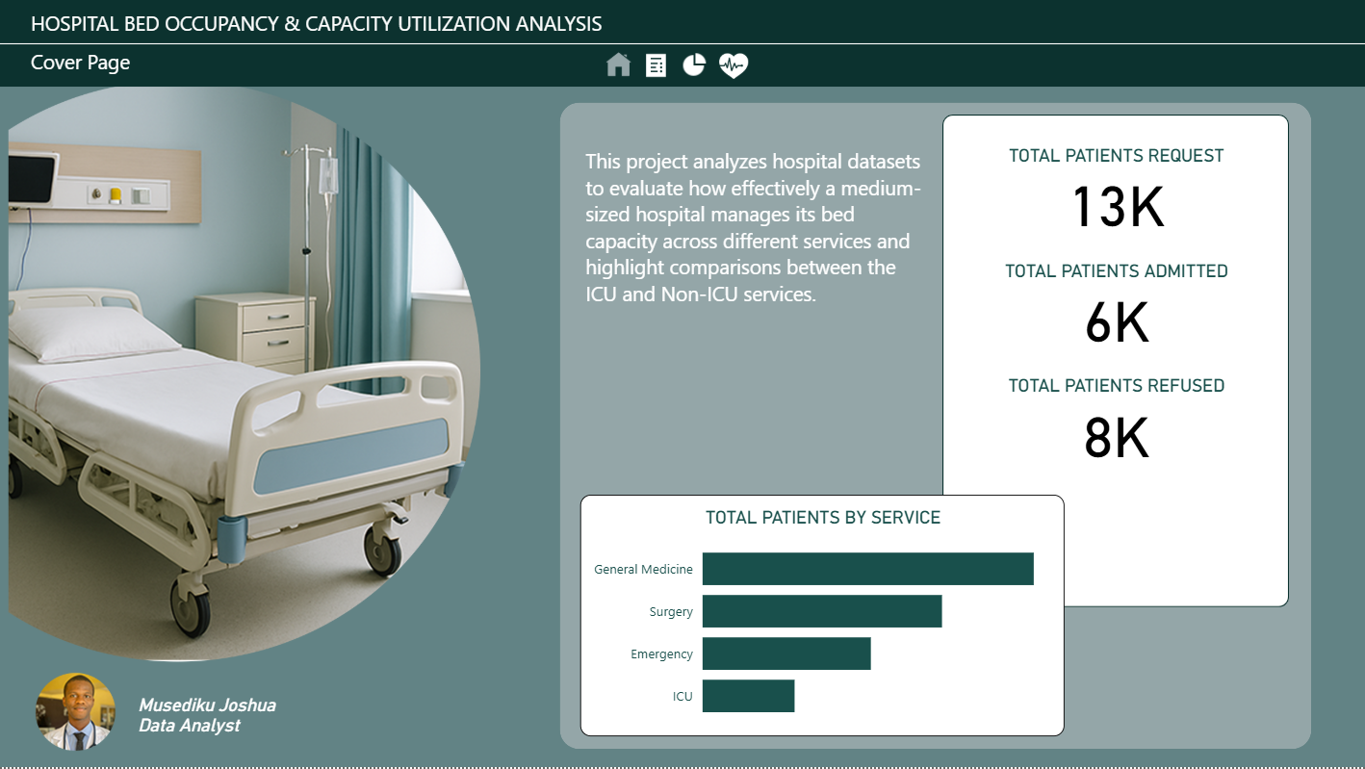
Dashboard Preview

Slide 9
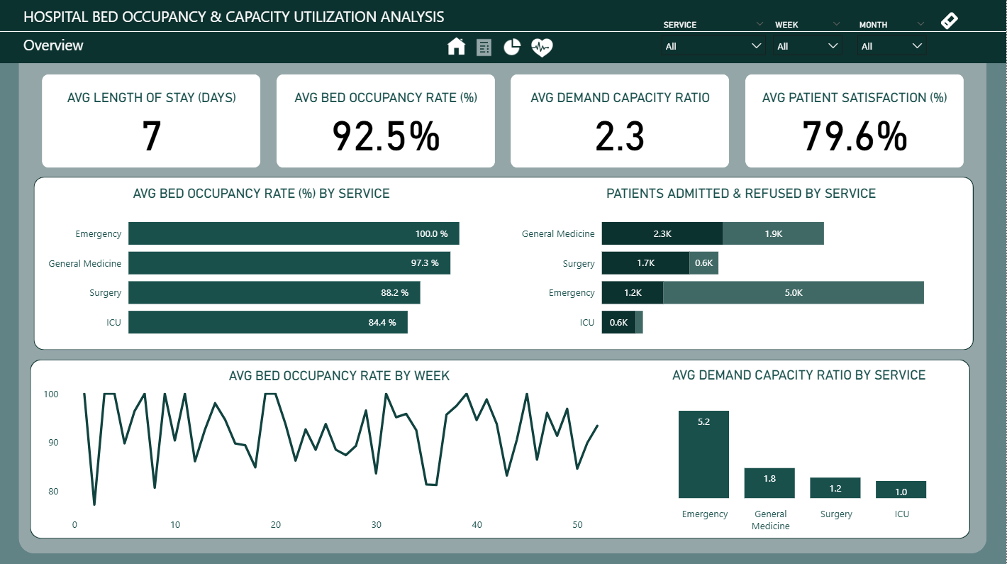
Dashboard Preview

Slide 10
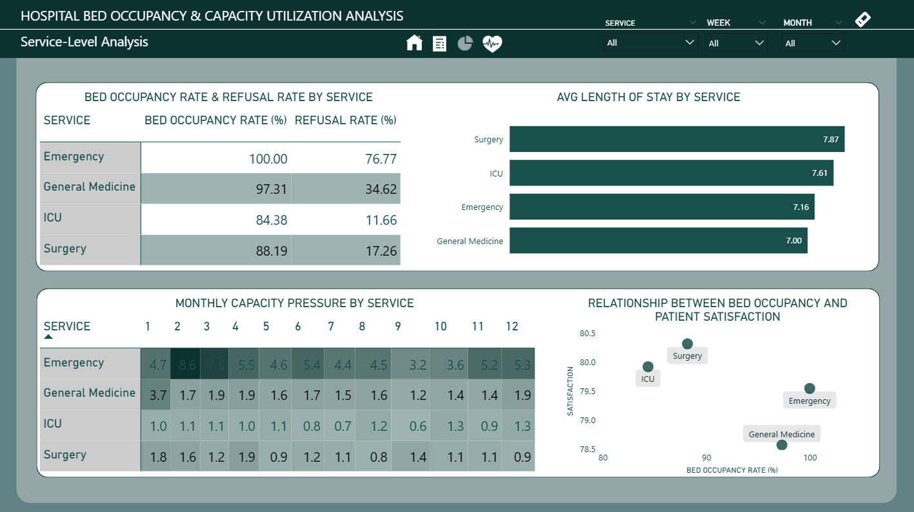
Dashboard Preview

Slide 11
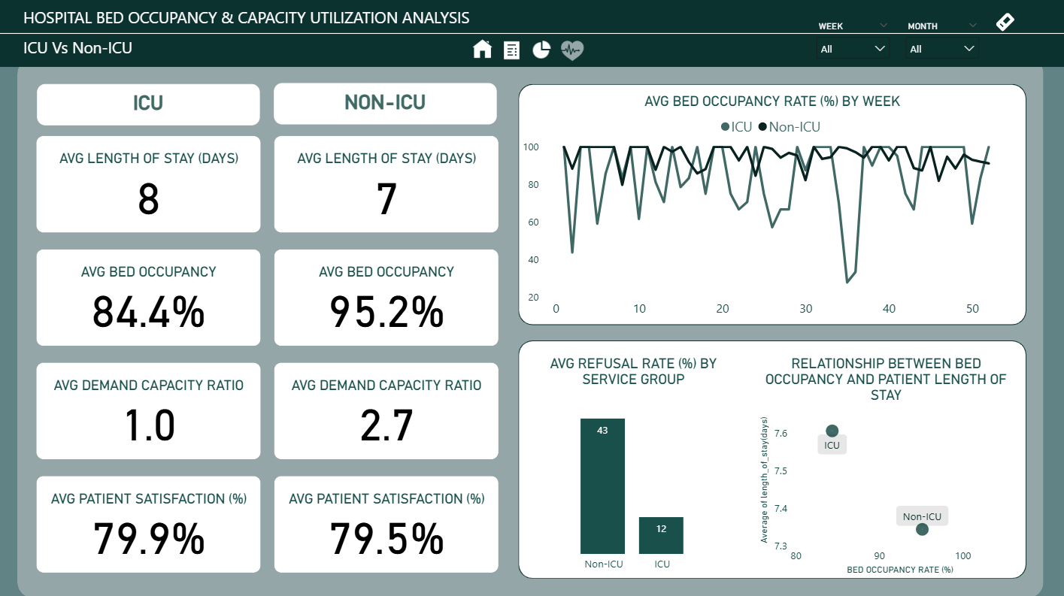
Dashboard Preview

